Slide 1
K-Means Parallel Project
Massive DyNamic:
Liron Mizrahi, Daniel da Silva, Fran-pierre Nel and Jason Chalom

Slide 2
K-Means Clustering
K-means is one of the simplest unsupervised learning algorithms to solve a
clustering problem. Clustering is the process of partitioning a group of data
points into a small number of clusters. In general, a cluster is defined as a set
of similar objects. The similarity in a given set may vary according to data,
therefore a clustering algorithm that finds an optimization in one set of data
may not find an optimization in another set of data.
There are many variations of the k-means clustering algorithm, however we have
looked at 2 of them, namely the normal k-means clustering and online k-means
clustering.

Slide 3
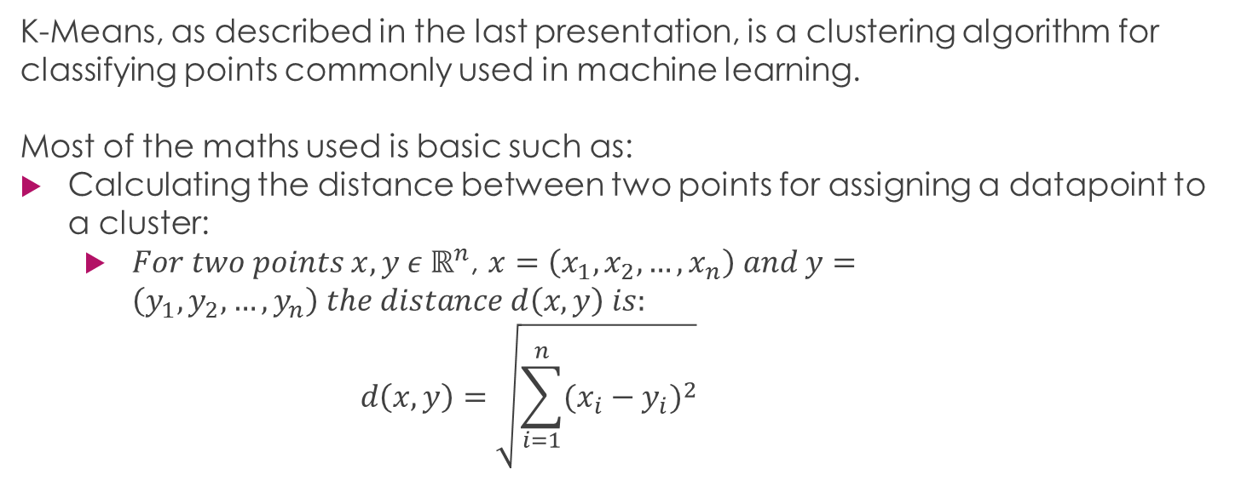
Maths Behind K-Means

Slide 4
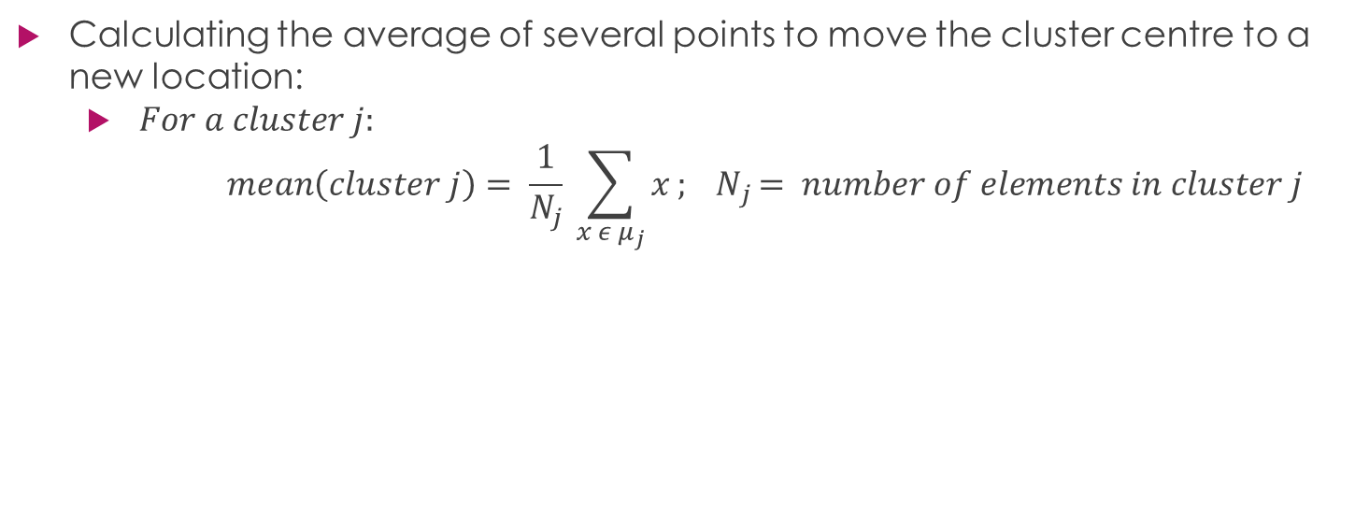
Maths Behind K-Means

Slide 5
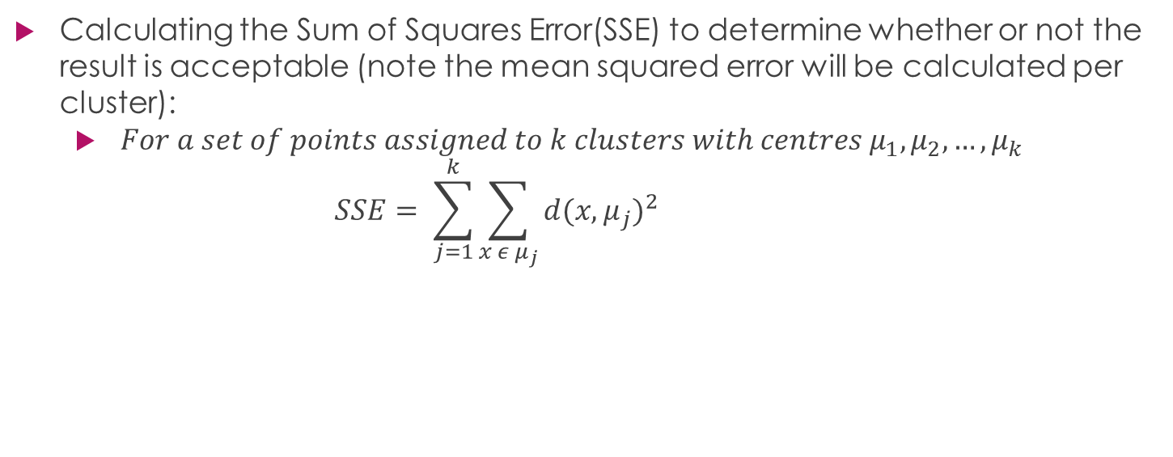
Maths Behind K-Means

Slide 6
What happened with Online K-Means?
Normal K-Means works with data which has been defined beforehand.
Online K-Means works on live streams of data
It depends on prior calculations
This makes it hard / illogical to parallelize to any degree where there would be desirable performance gains.

Slide 7
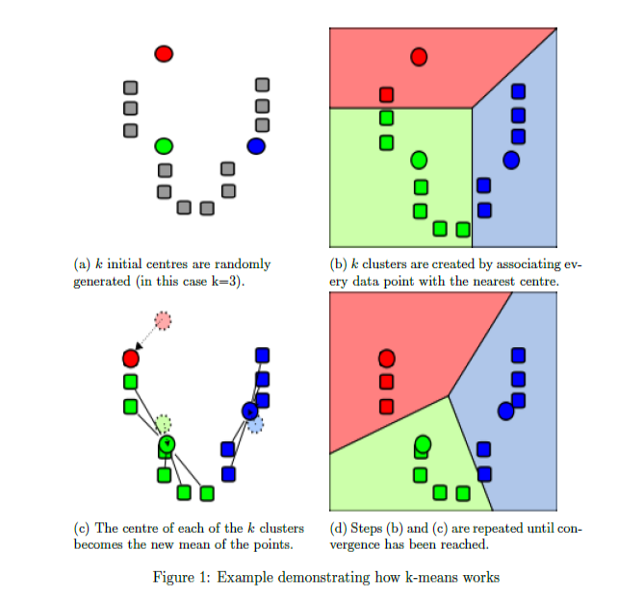
What is K-Means
https://en.wikipedia.org/wiki/K-means_clustering

Slide 8
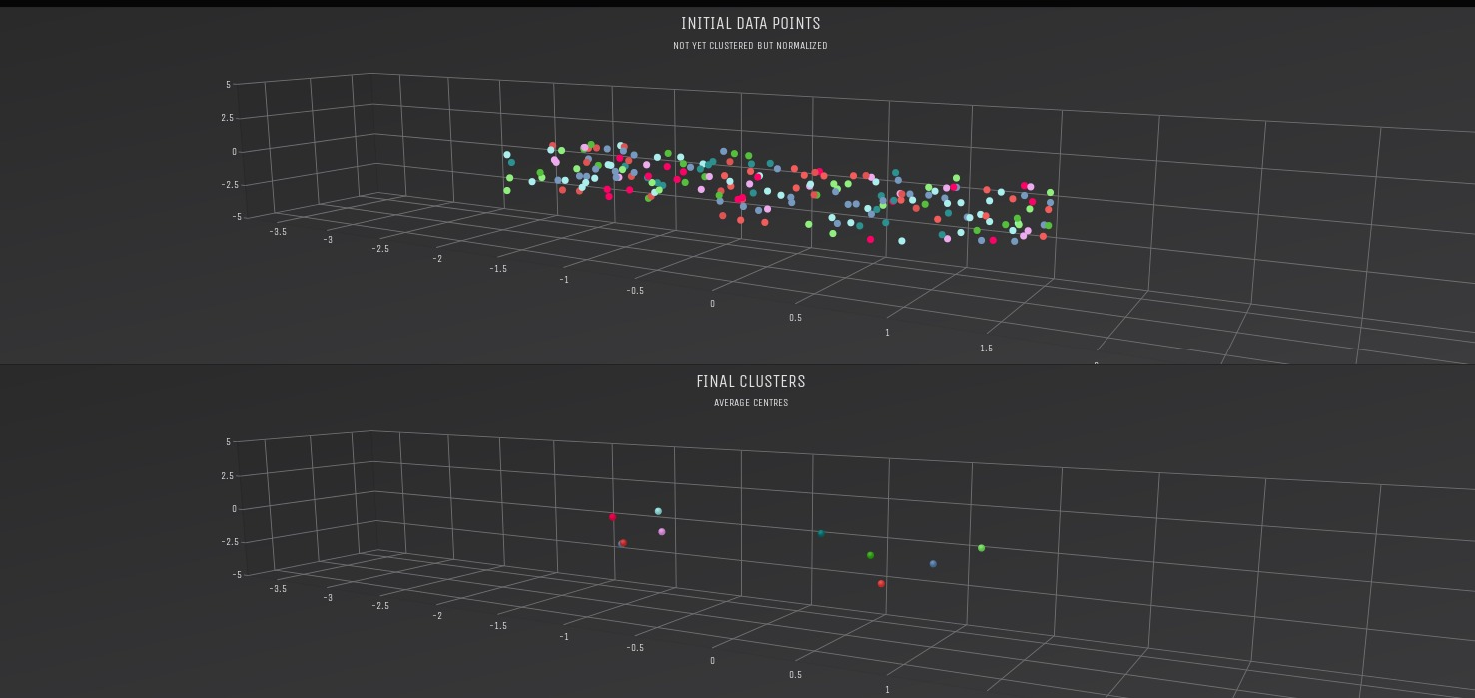
What is K-Means
See Demo With GUI

Slide 9
Three Aspects We Have Considered
The k-means algorithm has multiple ways it can be parallelized. Specially we look at the following three aspects:
Iterations over data points
Iterations over clusters
Iterations over dimensions

Slide 10
Difference between the two code bases
One is very good at showing what clustering does graphically
The other one is a far better strategy in showing how parallelization fits neatly with the k-means algorithm.
Why two code bases?
We made an initial one (The graphical one) and realised that it was not ideal for this project. Rather than scrap that code and therefore our time we have included it in this demonstration to illustrate k-means.

Slide 11
Data Decomposition

Slide 12
Task Dependency

Slide 13
Task Decomposition

